Slide 1
Characterizing the Bilingual Educator
Phd Candidate: Arsenia Anagnou
University of Alicante, Spain
July,2024

Slide 2
BILINGUAL EDUCATION
Bilingual education (BL) involves instructing students in academic content using both their native language and the host country's second language.
This method seeks to develop students' fluency in both languages, while also ensuring they attain language acquisition and academic proficiency across different subjects.
(Baker, 2011; Cummins, & Hornberger, 2008 ;García, 2009)

Slide 3
Types of Bilingual Education Programs
Transitional Bilingual Education (TBE): Students start learning in their native language and gradually transition to the second language.
Dual-Language or Two-Way Immersion Programs: Both native speakers of the target language and English speakers are taught together, with instruction delivered in both languages.
Maintenance or Developmental Bilingual Education: Aims to maintain and develop the student's native language while they learn a second language.
(Cummins, & Hornberger, 2008; García, 2009; U.S. Department of Education, 2015)

Slide 4
Goals and Benefits of Bilingual Education
Linguistic Proficiency: Ensuring students become proficient in both languages.
Academic Achievement: Helping students meet standard educational benchmarks in all subjects.
Cultural Competence: Promoting understanding and appreciation of different cultures.
Cognitive Advantages: Enhanced problem-solving skills, creativity, and multitasking abilities.
Academic Benefits: Improved academic performance in both languages.
Economic Opportunities: Better job prospects in a globalized economy.
Social and Cultural: Greater cultural awareness and sensitivity.
(August, & Shanahan, 2006;Thomas, & Collier, 2002)

Slide 5
Implementing Bilingual Education: Key Challenges and Solutions
Resource Intensive: Requires qualified teachers, appropriate materials, and administrative support.
Language Dominance: Ensuring both languages receive adequate attention and instruction.
Policy and Attitudes: Varies by region, with some areas being more supportive of bilingual education than others.
Curriculum Design: Balancing both languages in the curriculum.
Teacher Training: Ensuring educators are proficient in both languages and understand bilingual teaching strategies
Assessment: Developing fair and accurate methods to assess students' proficiency and academic progress in both languages.
(Genesee, 1999; Thomas, et al., 2002;Valdés, et al. 2005)

Slide 6
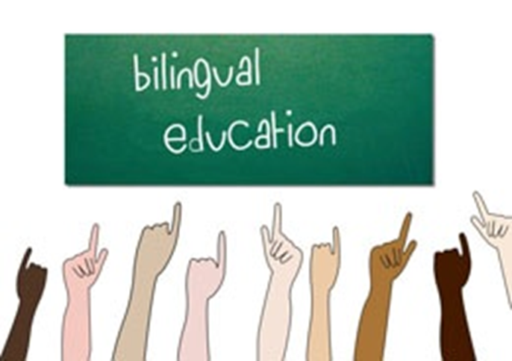
BILINGUAL EDUCATOR
Hornberger (2004) notes that the bilingual teacher embodies a combination of three dimensions:
Situated research
Teaching
Language planning in linguistically diverse settings.
(Hornberger,2004)

Slide 7
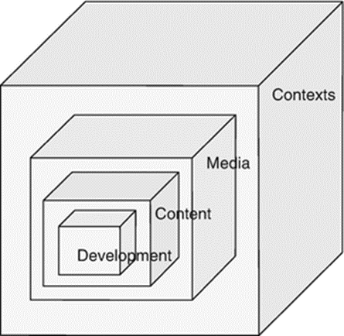
A Bilingual Educator needs to…
Focus on the aspects of continua biliteracy:
Development
Content
Media
Contexts
(Hornberger,2004)

Slide 8
Integrating Innovation and Cultural Awareness in Bilingual Education
Evolution of freedom to innovate everything new and pioneering with respect to theories and the classroom context.
Awareness that global and local economic, sociopolitical circumstances impact education.
Involvement with respectful consideration of local community beliefs, culture, and attitudes.
Utilization of new media technology tools to enhance communication.
Preparation of students' skills for future aspects such as job finding.
(Hornberger,2004;Penn GSE Edcasts,2011; Unesco,2020)

Slide 9
Adapting and Innovating in Multilingual Education: Principles for Effective Teaching
The application of flexibility to change, negotiation, and adjustment of content to classroom needs and interests incorporates a critical view of new communicative forms and practices.
The embrace of the acknowledgment that teachers, researchers, and graduate students form a collaborative community rather than a competitive one.
The implementation of multiple methods for teaching multilingual education.
(Hornberger,2004;Penn GSE Edcasts,2011; Unesco,2020)

Slide 10
Navigating the Language, Culture, and Identity Dilemma in BE
The dilemma of language, culture, and identity is a dynamic process involving overlapping language affiliations.
Acknowledge, utilize, and expand the linguistic repertoire of students.
Collaboratively create new policies and rules with learners.
Consciousness of language rights throughout the process.
(Hornberger,2004;Penn GSE Edcasts,2011; Unesco,2020)

Slide 11
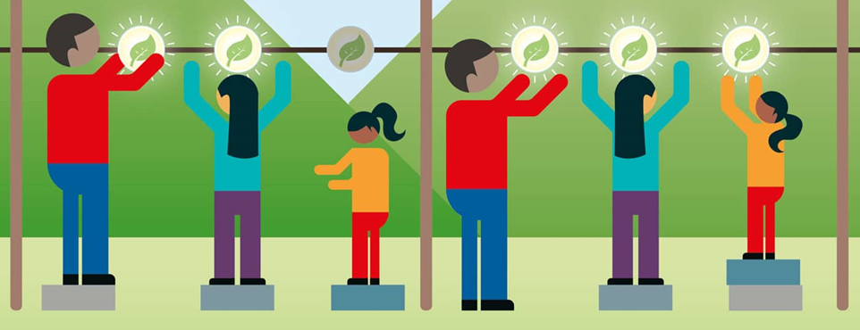
Roles and Responsibilities of Bilingual Educators in Diverse Educational Settings
As Hornberger illustrates: “Bilingual educators are simultaneously researchers, teachers, and language planners” (p.168).
Offer equal educational framework.
Speak their language.
Make connections.
Create a sense of acceptance.
(Hornberger,2004;Penn GSE Edcasts,2011; Unesco,2020)

Slide 12
REFERENCES
August, D., & Shanahan, T. (Eds.). (2006). Developing Literacy in Second-Language Learners: Report of the National Literacy Panel on Language-Minority Children and Youth. Lawrence Erlbaum Associates.
Baker, C. (2011). Foundations of Bilingual Education and Bilingualism (5th ed.). Multilingual Matters.
Cummins, J., & Hornberger, N. H. (Eds.). (2008). Encyclopedia of Language and Education (2nd ed.). Springer.
García, O. (2009). Bilingual Education in the 21st Century: A Global Perspective. Wiley-Blackwell.
Genesee, F. (Ed.). (1999). Program Alternatives for Linguistically Diverse Students. Center for Research on Education, Diversity & Excellence.
Hornberger, N. (2004). The continua of biliteracy and the bilingual educator: Educational linguistics in practice. Bilingual Education and Bilingualism, 7(2&3), 155-171. http://login.proxy.eap.gr/login?url=http://dx.doi.org/10.1080/13670050408667806
The Penn GSE Edcasts – Does multilingual Education Matter? (7 June 2011, Duration: 14.36΄) https://www.youtube.com/watch?v=5KKhpZ3C9ek
Thomas, W. P., & Collier, V. P. (2002). A National Study of School Effectiveness for Language Minority Students' Long-Term Academic Achievement. Center for Research on Education, Diversity & Excellence.
U.S. Department of Education. (2015). Dual Language Education Programs: Current State Policies and Practices. Office of English Language Acquisition. Retrieved from: https://files.eric.ed.gov/fulltext/ED601041.pdf
UNESCO (2020). Global Education Monitoring Report Inclusion and education: All means all, United Nations Educational, Scientific and Cultural Organization
https://en.unesco.org/gem-report/report/2020/inclusion
Valdés, G., Bunch, G., Snow, C. E., & Lee, C. (2005). Bilingualism and Education. In D. L. R. Vandeyar, L. (Ed.), Handbook of Research in Second Language Teaching and Learning (pp. 107-122). Routledge.

